Slide 1
Customer Churn Analysis for Auto Insurance
FINAL FROJECT: TEAM 06
Distributed and Scalable Data Engineering

Slide 2
OUR TEAM
Radiah Zaman Sarin
Kavya
Uday Shankar Agasti
Venu Gopal Reddy
Data Engineer ML Engineer Data Analyst Research And Documentation

Slide 3
Business Scenario overview
Problem Statement:
Auto insurance companies struggle with customer churn, impacting revenue, satisfaction, and retention. Identifying and addressing churn factors is crucial for sustained growth and competitiveness.
Solution Requirements:
Our project aims to address auto insurance customer churn by leveraging data and technology. We'll focus on three key components:
Efficient Data Processing: Streamlining the handling of diverse data sources to extract valuable insights efficiently.
Insightful Analysis: Utilizing advanced analytics to accurately identify churn patterns and drivers.
Informed Decision-Making: Delivering actionable insights to stakeholders for proactive retention strategies and personalized customer engagement.

Slide 4
Solution overview
High-Level Description:
Our project, "Churn Analysis Using Auto Insurance Data on AWS Cloud," represents a pioneering effort to revolutionize how auto insurance companies approach customer churn. By harnessing the cutting-edge capabilities of AWS Cloud services, we have crafted an end-to-end solution that transcends traditional approaches to churn analysis. Our solution not only addresses the immediate needs of data processing and analysis but also lays the foundation for continuous innovation and adaptation in a dynamic industry landscape.
Design Considerations: Central to our solution is the seamless integration of various AWS services, each meticulously chosen to maximize efficiency and scalability:
ETL Pipeline with AWS Glue: Efficiently extract, transform, and load data for streamlined insights.
Ad-Hoc Querying with AWS Athena: Efficiently extract, transform, and load data for streamlined insights.
Insightful Visualization with Power BI: Enable intuitive exploration of churn patterns and trends.
Predictive Modeling: Utilize advanced ML for churn prediction, enabling proactive intervention and retention strategies.

Slide 5
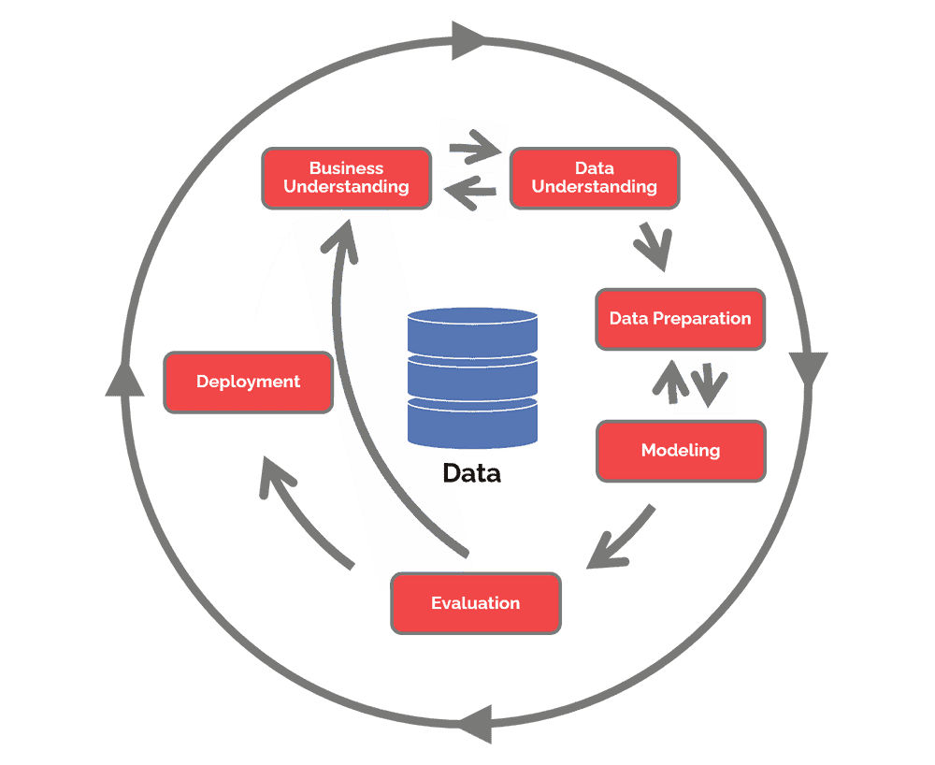
Methodology crisp-ml
GAIN BUSINESS UNDERSTANDING
DATA COLLECTION AND INTEGRATION
DATA CLEANING AND PREPARATION
DATA MODELING AND ANALYSIS

Slide 6


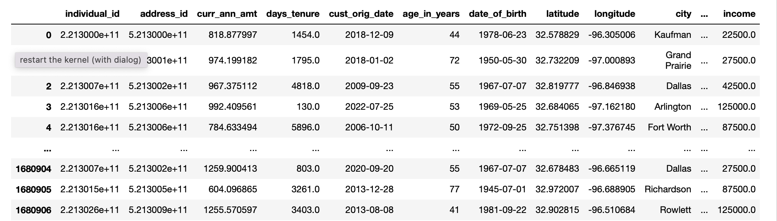
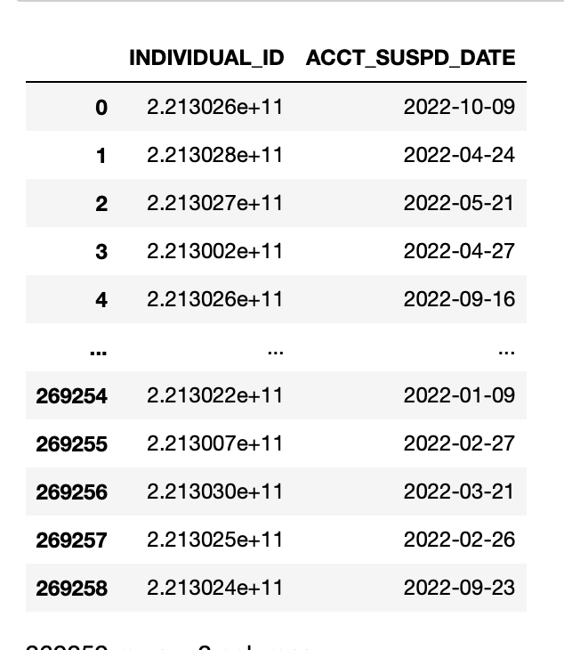
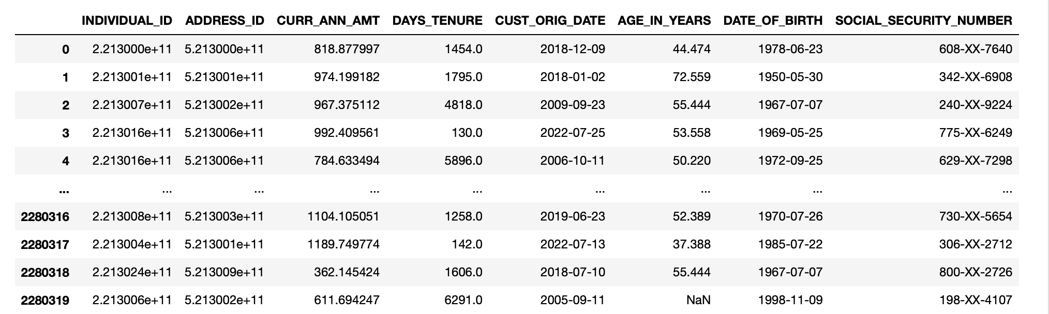
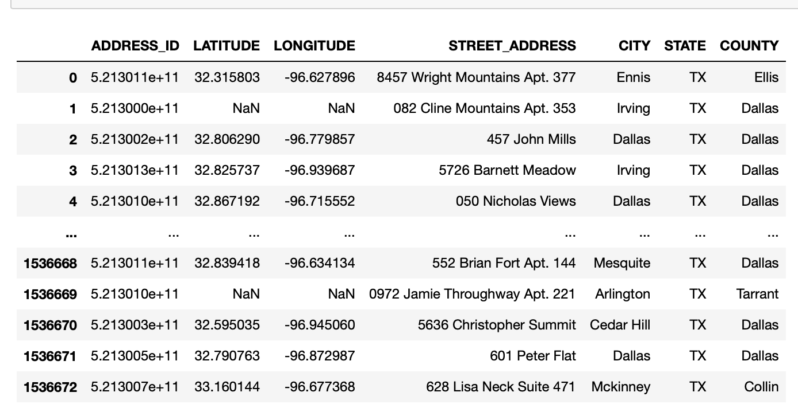
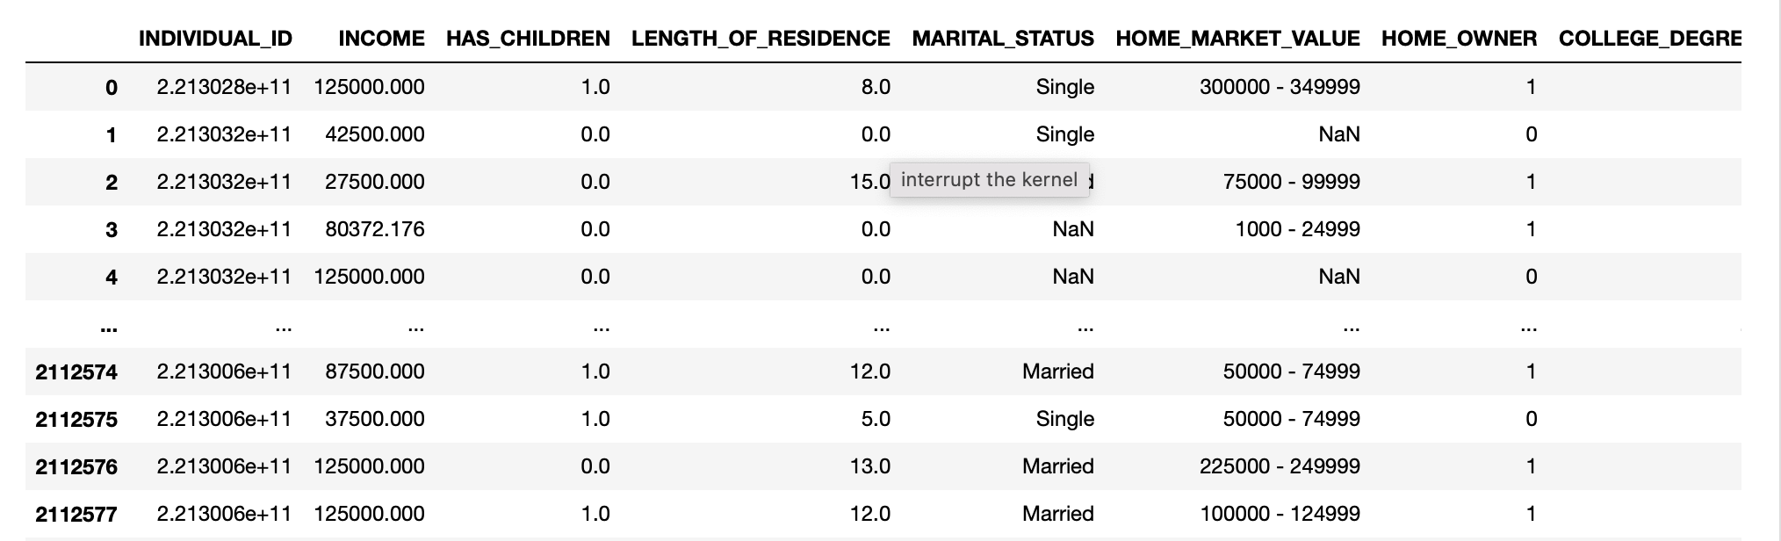
Dataset
autoinsurance_churn.csv
customer.csv
termination.csv
We Had 5 individual Datasets
address.csv
demographic.csv
Dataset: https://www.kaggle.com/datasets/merishnasuwal/auto-insurance-churn-analysis-dataset?select=address.csv

Slide 7
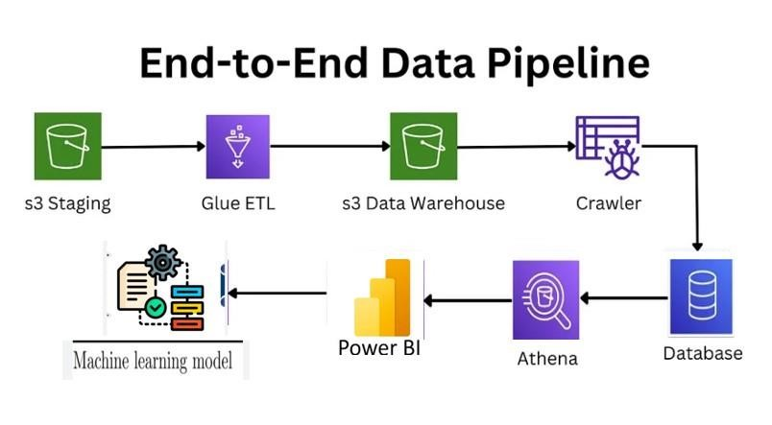
Architecture diagram of the solution

Slide 8
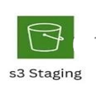
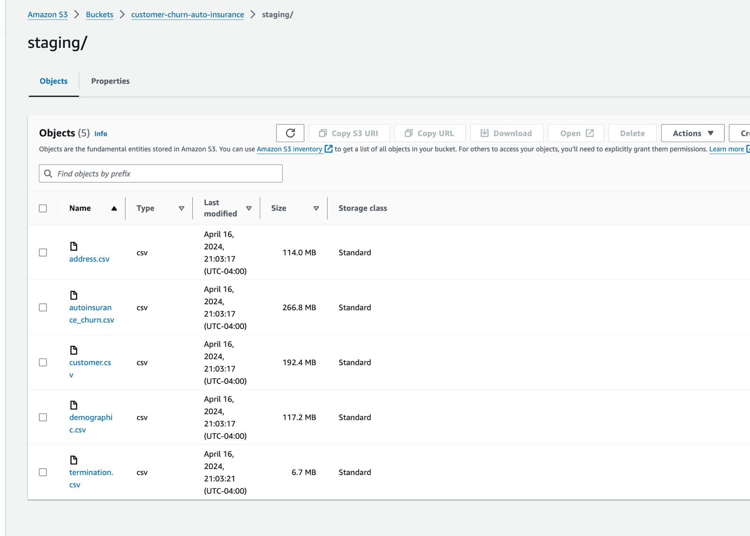
S3 STAGING
We utilize an S3 bucket as the primary repository for raw data, acting as our staging layer.

Slide 9

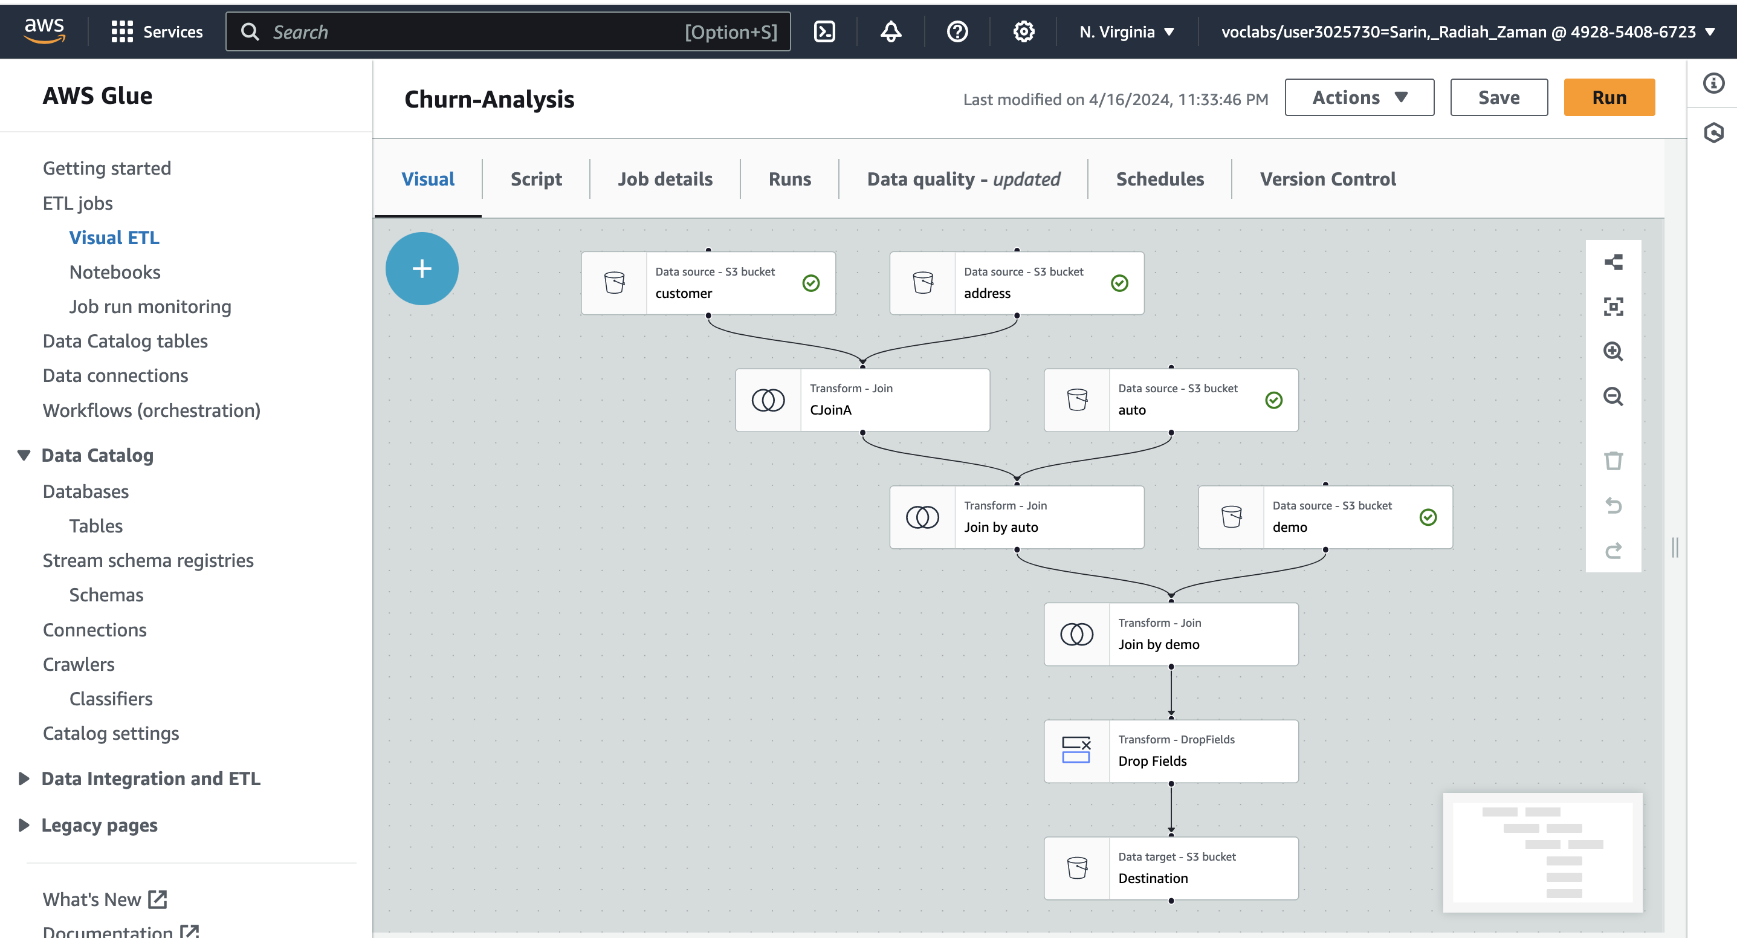
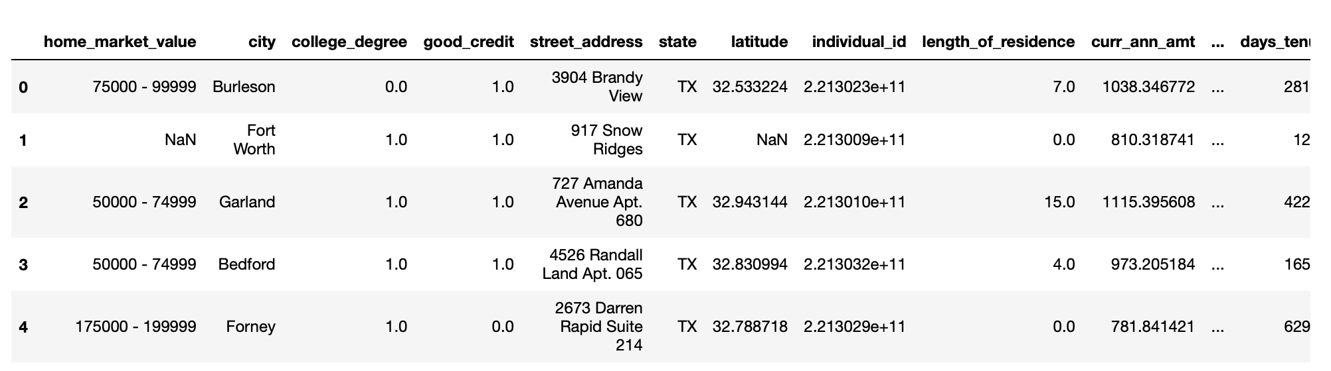
Glue etl
Next, we harness AWS Glue to build our ETL pipeline. This pipeline smoothly extracts data from the S3 bucket, executes vital transformations such as cleaning and joining operations, guaranteeing the data's precision and consistency. These procedures are pivotal in enhancing the dataset and priming it for deeper analysis.
Data Cleaning and Integration
Joining in AWS GLUE(Visual ETL)
Final Dataset

Slide 10
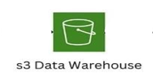
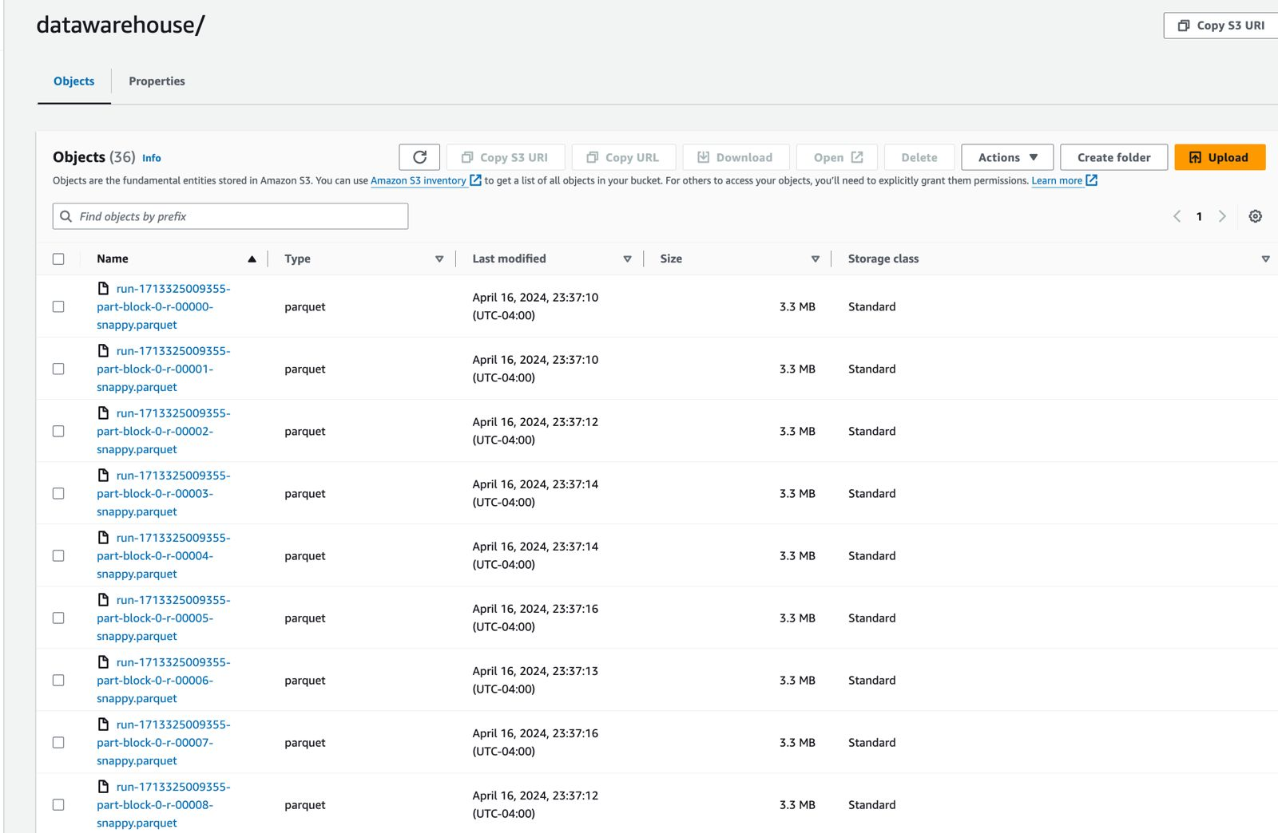
S3 Datawarehouse
After the data undergoes transformation with AWS Glue, it is loaded into our data warehouse.

Slide 11

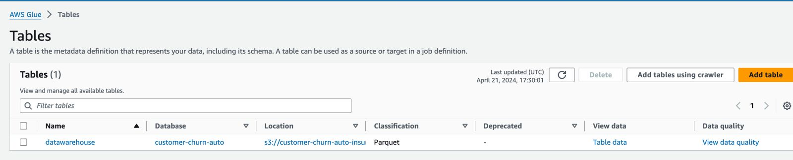
Glue crawler
Once the data is securely stored in our data warehouse, we initiate a Glue crawler to establish and populate a database with tables. This automated process streamlines data management, facilitating efficient organization and accessibility.

Slide 12

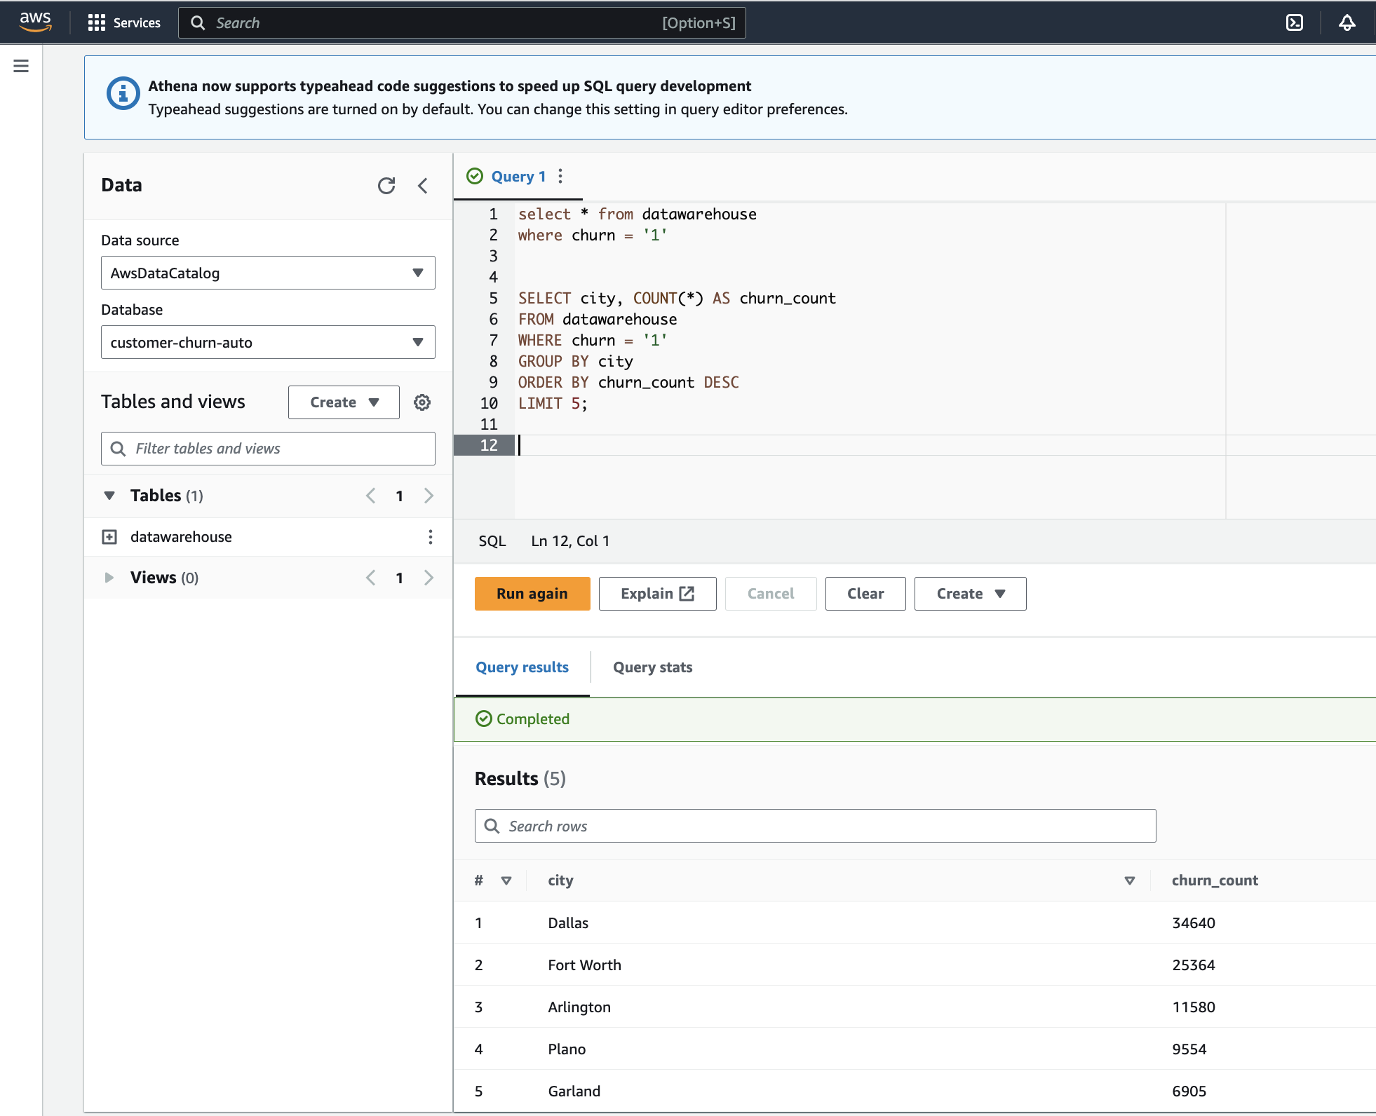
AWS ATHENA
To facilitate querying, we rely on AWS Athena, harnessing its capabilities to seamlessly explore and analyze the data stored in our database tables. This empowers us to derive valuable insights and make informed decisions based on our data analysis, as outlined below:
Query1: Identify the top 5 cities with the highest churn rates:

Slide 13
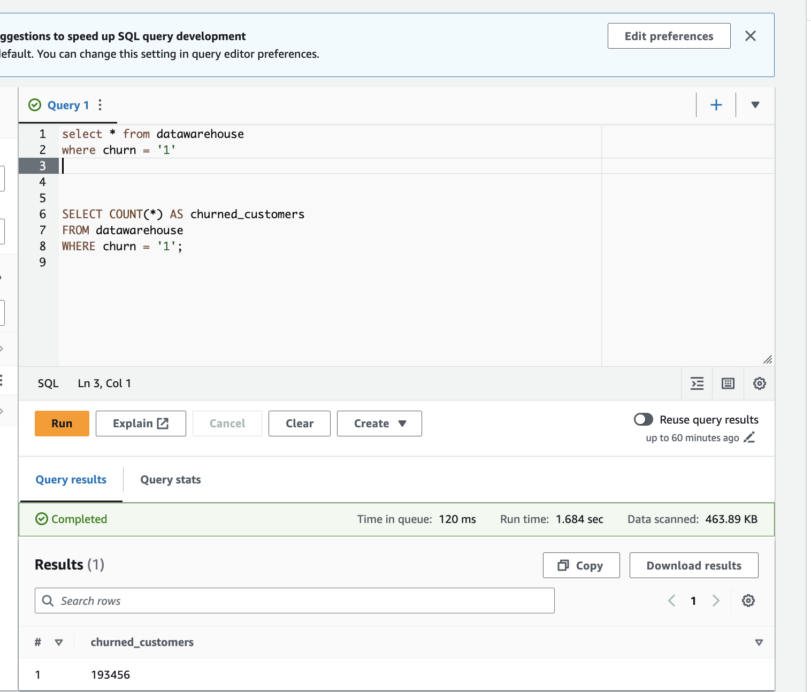
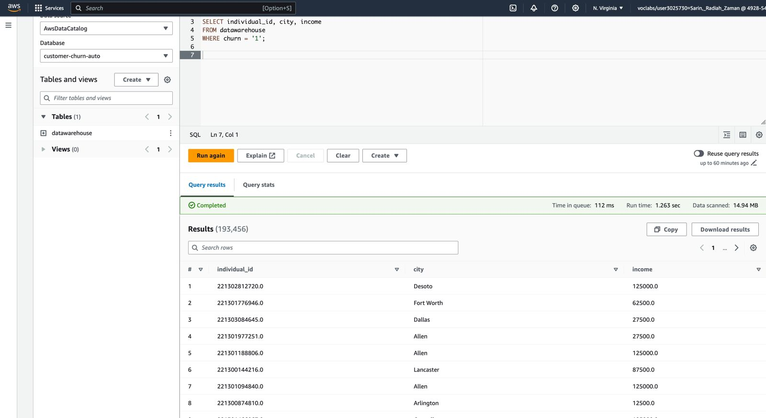
Find the number of customers who churned:
Identify the churned customers along with their city and income:

Slide 14

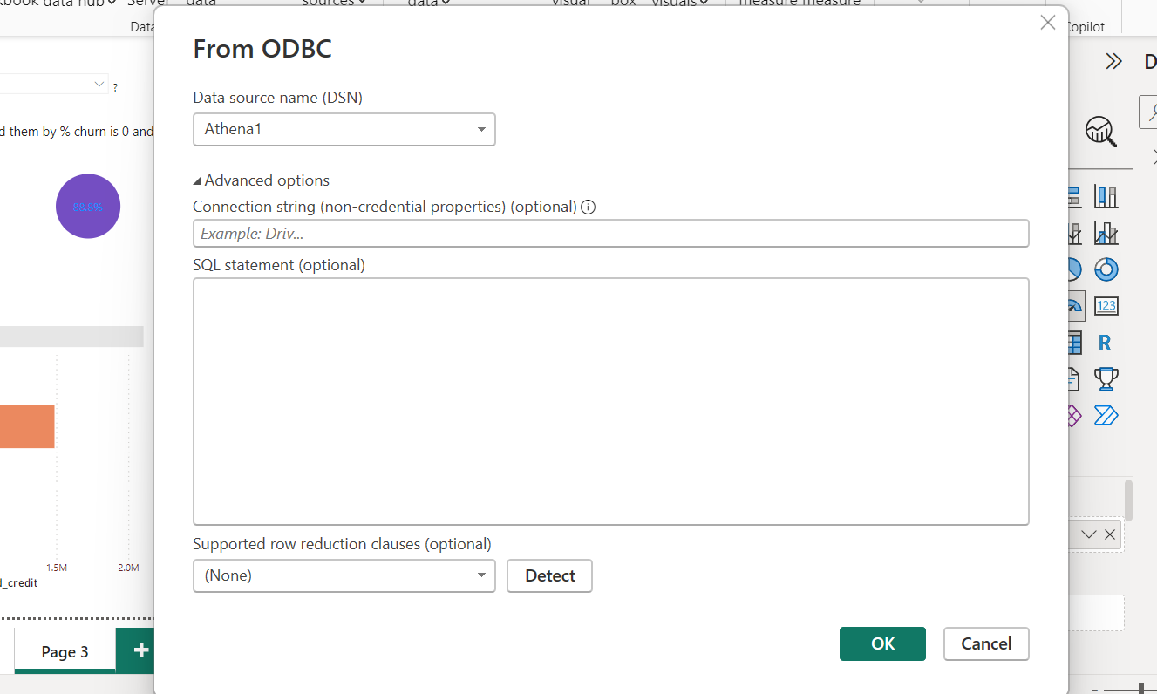
POWER BI
To visualize our findings and gain actionable insights, we connect our AWS dataset from the S3 bucket to Power BI. This integration enables intuitive visualizations, empowering us to extract valuable business insights and identify trends effectively, as described in the FOLLOWING SLIDES:

Slide 15
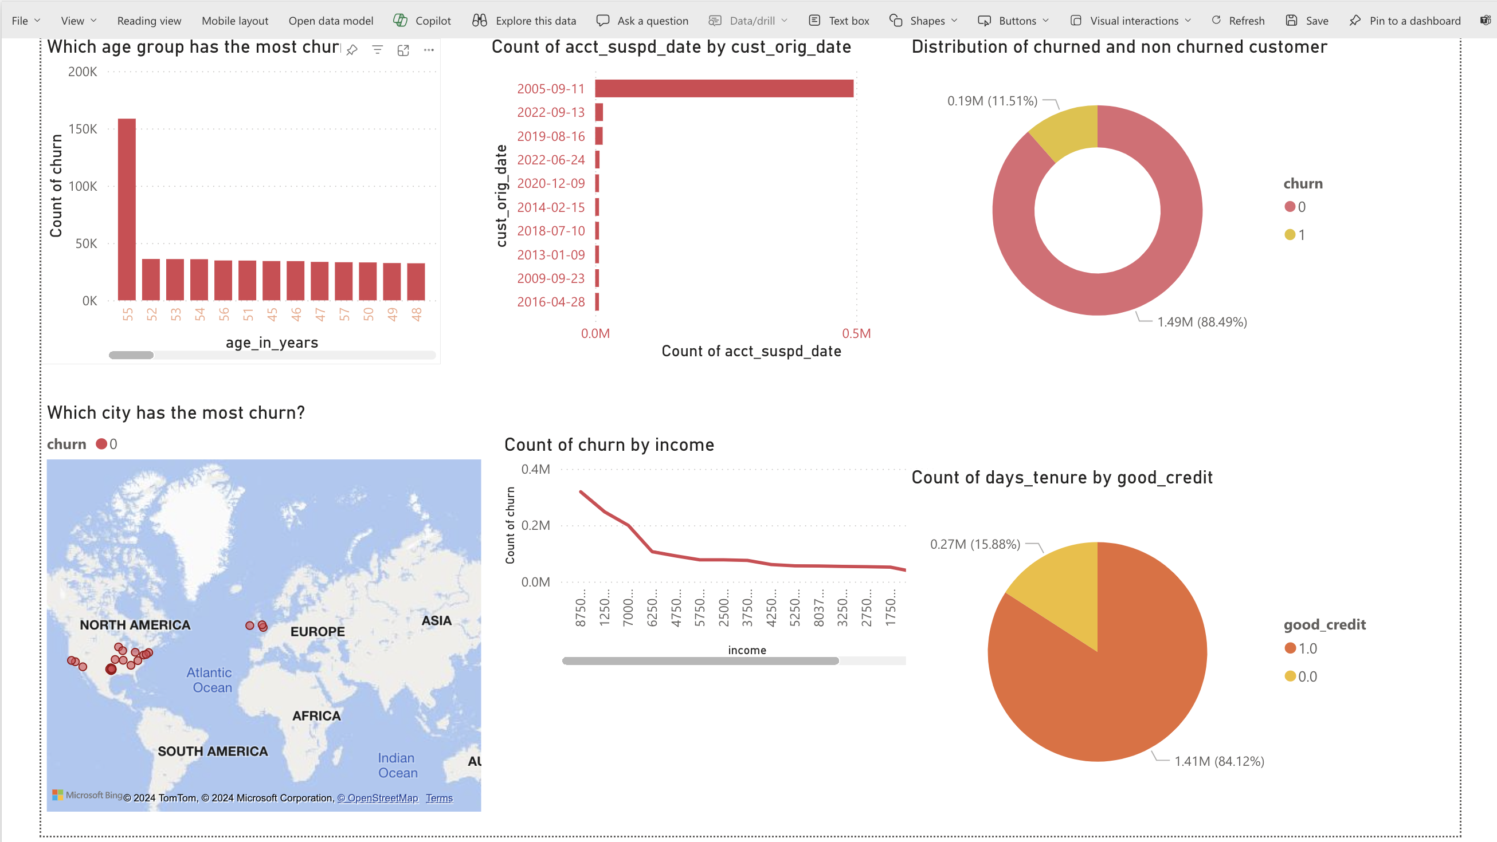
Power Bi visualization

Slide 16
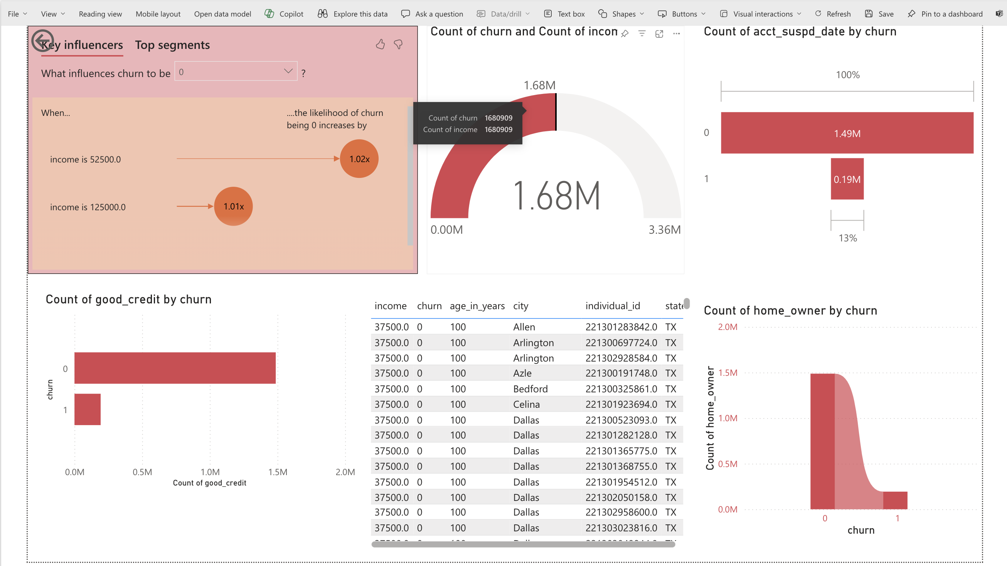
Power Bi visualization

Slide 17
Machine learning models
In conclusion, we leverage machine learning techniques for predictive analytics, allowing us to forecast customer churn and implement proactive measures to optimize business outcomes. This predictive capability enhances our ability to anticipate future trends and make strategic decisions, thereby driving business success.
The models we utilize include
Logistic regression
KNN classifier
decision tree classifier
random forest classifier.

Slide 18
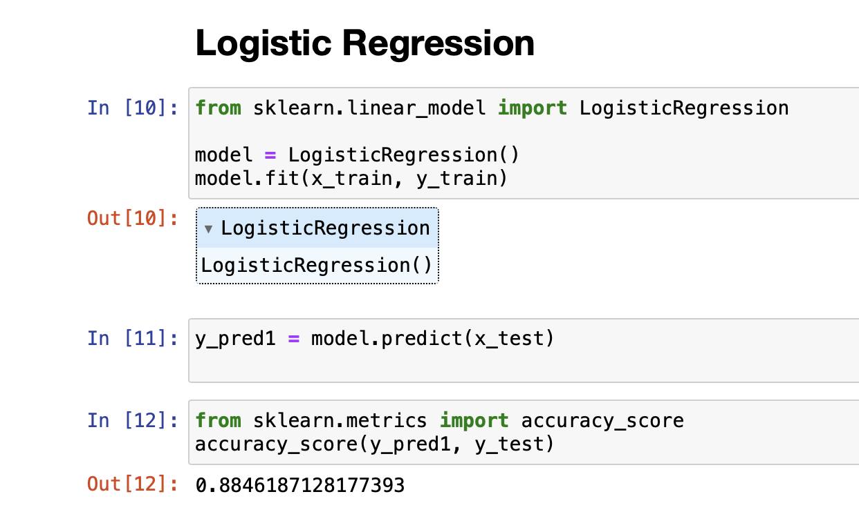
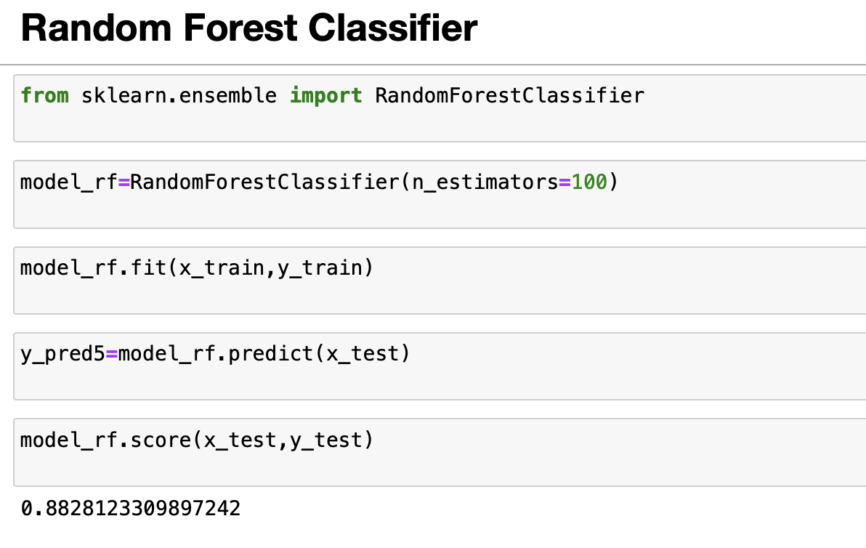
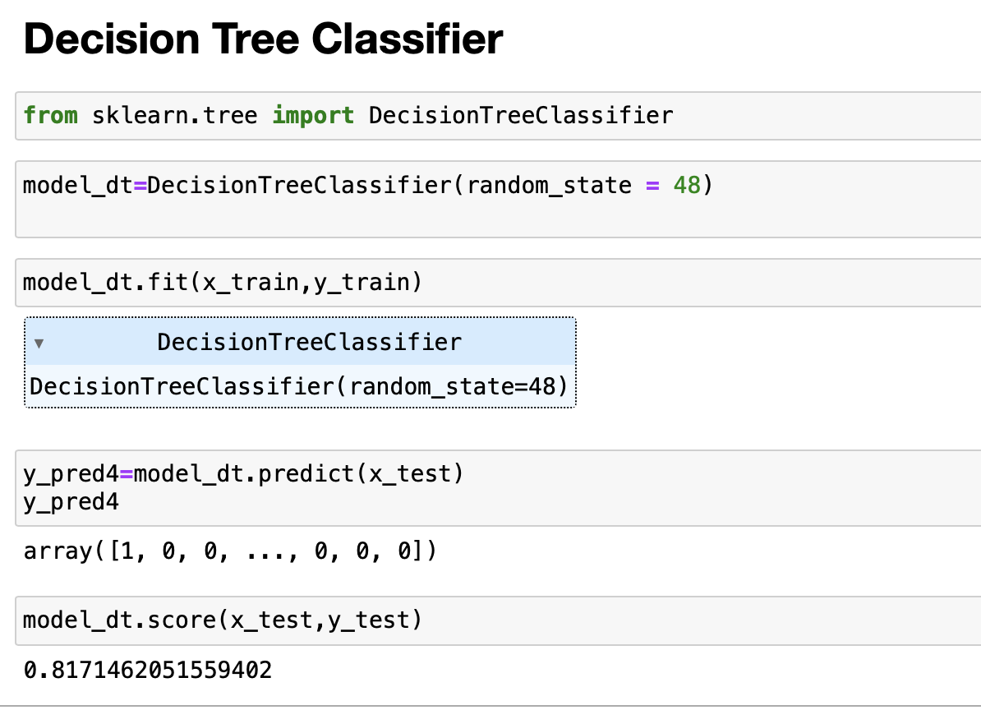
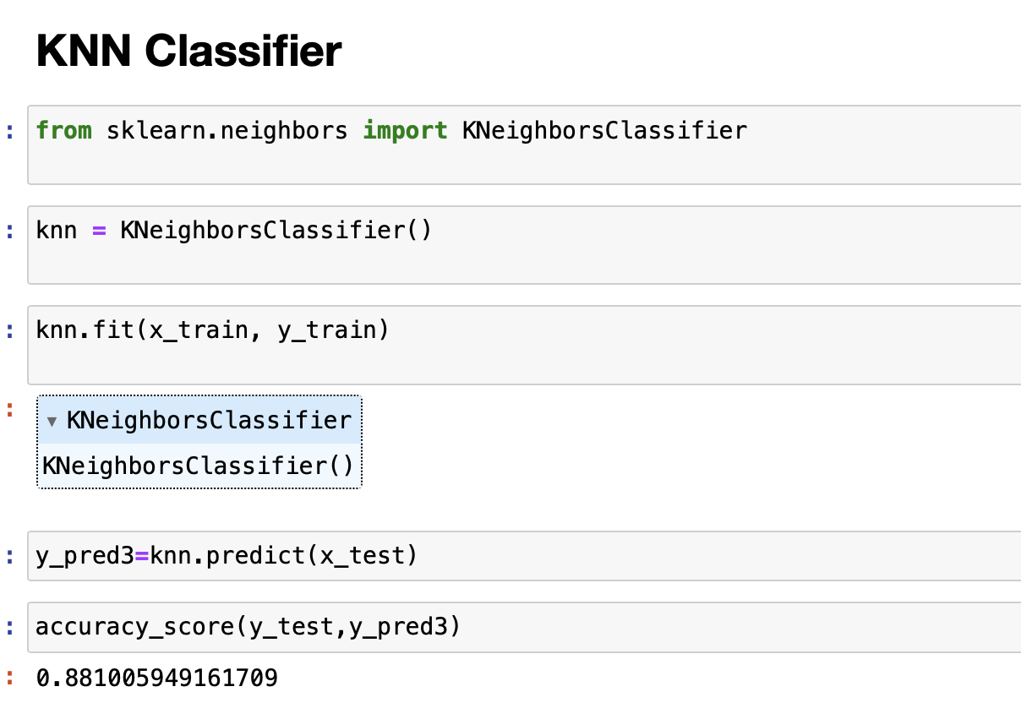

Slide 19
Model evaluation :
Logistic Regression achieved an accuracy score of 0.885 on the test set.
KNN Classifier achieved an accuracy score of 0.881 on the test set.
Decision Tree Classifier achieved an accuracy score of 0.817 on the test set.
Random Forest Classifier was also trained, achieving an accuracy score of 0.883 on the test set.
Model Comparison :
Logistic Regression outperformed the other models in terms of accuracy.
KNN Classifier and Random Forest Classifier also performed well but slightly lower than Logistic Regression.
Decision Tree Classifier had the lowest accuracy among the models evaluated.
Logistic Regression had the advantage of interpretability, while ensemble methods like Random Forest offered better predictive power.

Slide 20
Recommendations:
For this dataset and task, Logistic Regression may be the preferred choice due to its high accuracy and interpretability.
However, if predictive power is prioritized and interpretability is less critical, Random Forest could be considered.
Further optimization and feature engineering may improve the performance of the models, especially for Decision Tree Classifier.

Slide 21
Lessons learned
Challenges Overcame: Throughout the project, we encountered challenges such as data preprocessing complexities and model evaluation.
Helpful Resources: We found AWS documentation, online tutorials, and peer support forums invaluable in overcoming challenges and gaining insights.
New Skills: We developed proficiency in AWS services, data preprocessing techniques, and machine learning model evaluation.
Next Steps: Moving forward, we plan to refine our models, explore advanced analytics techniques, and enhance scalability for larger datasets.

Slide 22
DEMO
GitHub Link
Code File
Power BI Reports

Slide 23


